Slide 1
Churning rate and Branding Summary
Castle C : Oct 2018 – Sept 2019

Slide 2
Outline
Historical Data
Month in service
Brand List with high month in service
Package Distribution
Churning Rate over 12 months
Overall Brand Trending
Summary

Slide 3
Historical Data
Time Frame
October 2018 – September 2019 = 12 months
Data Collection
All records from sale team

Slide 4
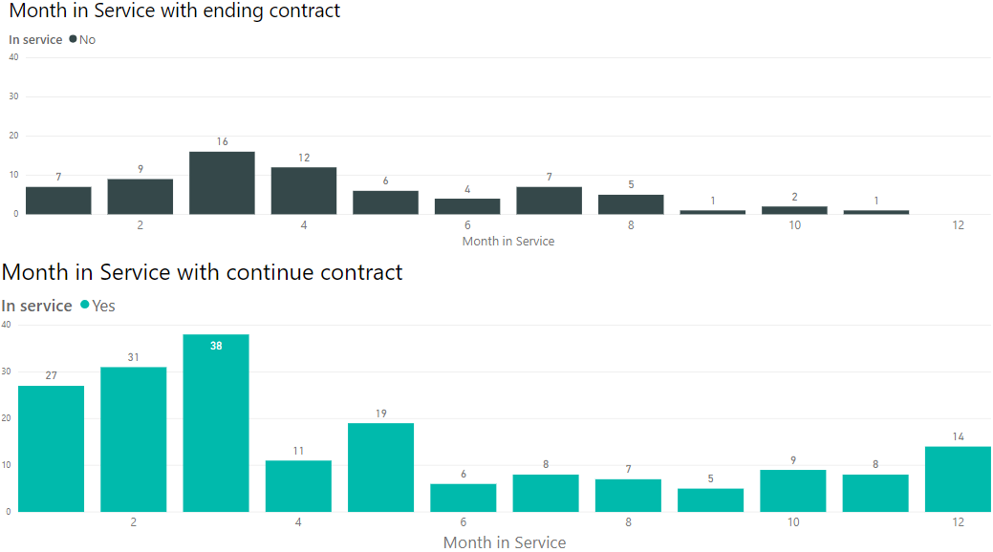
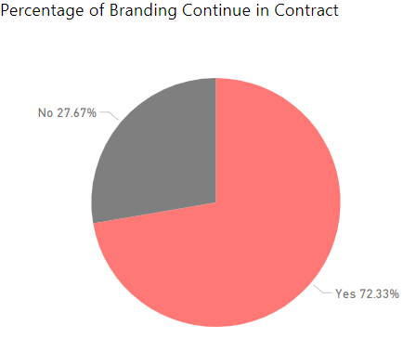
Month in service
Ongoing brand = 183 brands
Ending brand = 70 brands
80% of brands ending contract at 1 – 6 months.
14 brands continue full contract from Oct 2018 YTD
70 brands
183 brands

Slide 5
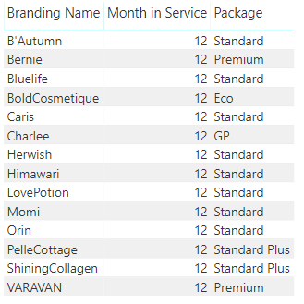
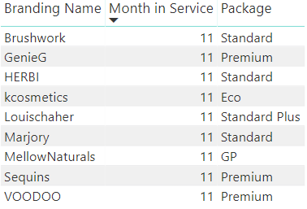
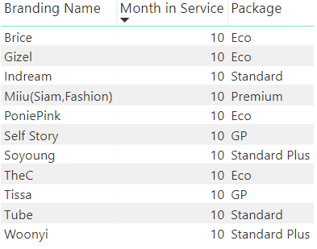
Brands List with high month in service 10 – 12 months
12 Months
11 Months
10 Months

Slide 6
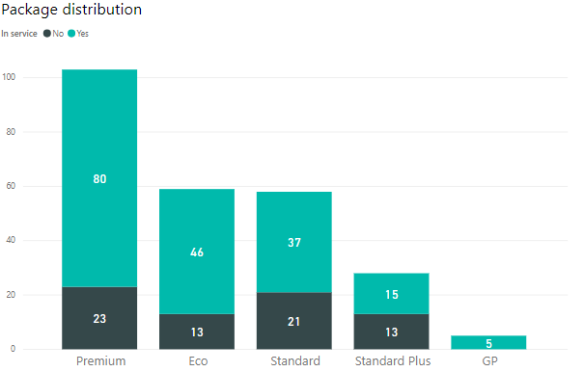
Package Distribution
“Premium” package got the highest popular
“Eco” and “Standard” got the second rank with same level
“GP” was the lowest rank in number.
Ending service number on “Premium” and “Standard” are the same
Also, “Eco” and “Standard Plus” are the same level of ending contract

Slide 7
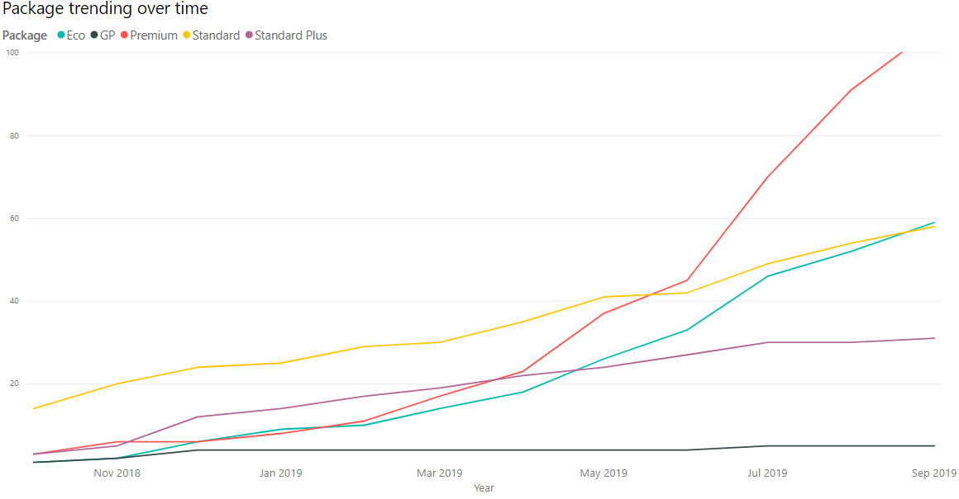
Package Distribution Overtime
“Premium” package increase popularity on June 2019
“Eco” package growth rate seem to be compromising. This package come-over “Standard Plus” and “Standard”

Slide 8
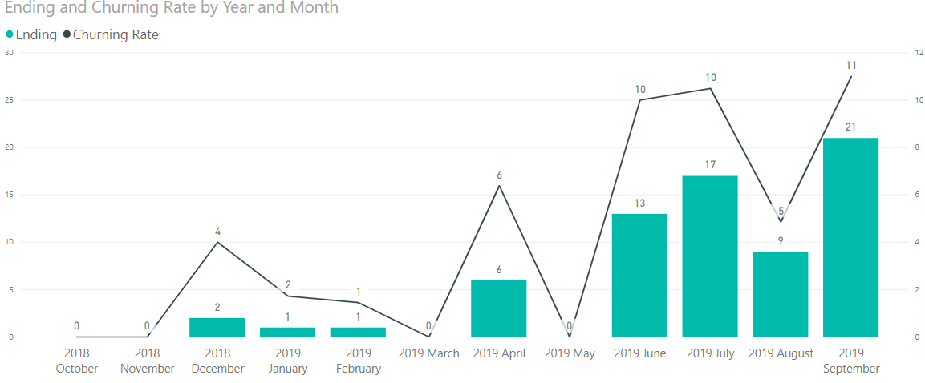
Churning Rate over 12 months
Churn rate = percentages of users who stop service within given period
Churn rate start to be positive rate from Q1 2019
After May 2019, churn rate increase more aggressively and stay stable on same level.

Slide 9
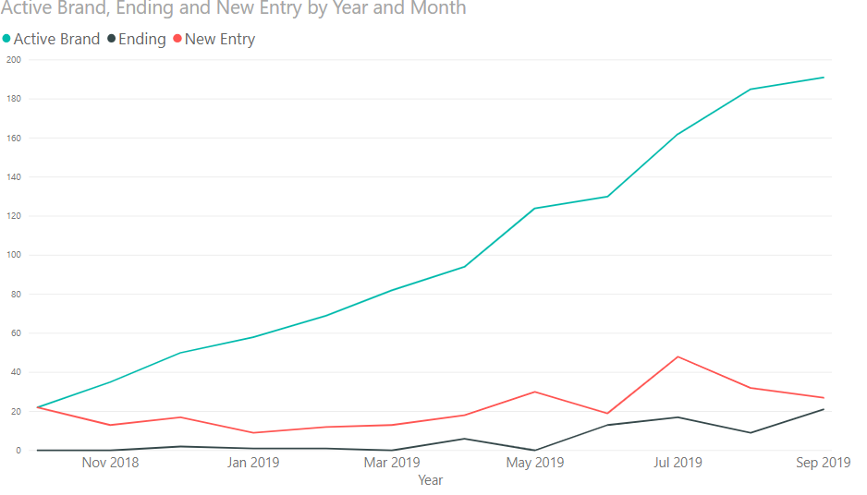
Overall Trending of Brands
Overall active brands is increasing
New entry brands number still higher than exit brands but both of them are on positive rate.

Slide 10
Summary

Slide 11
Q&A

